Slide 1
FaceBook
Stock Analysis
PART II
Junling Gao 001839851
Wenqing Liang 001873144 Ashish Kumar 001497334
Tripti Santani 001497382
Dipti Bhattad 001831210

Slide 2
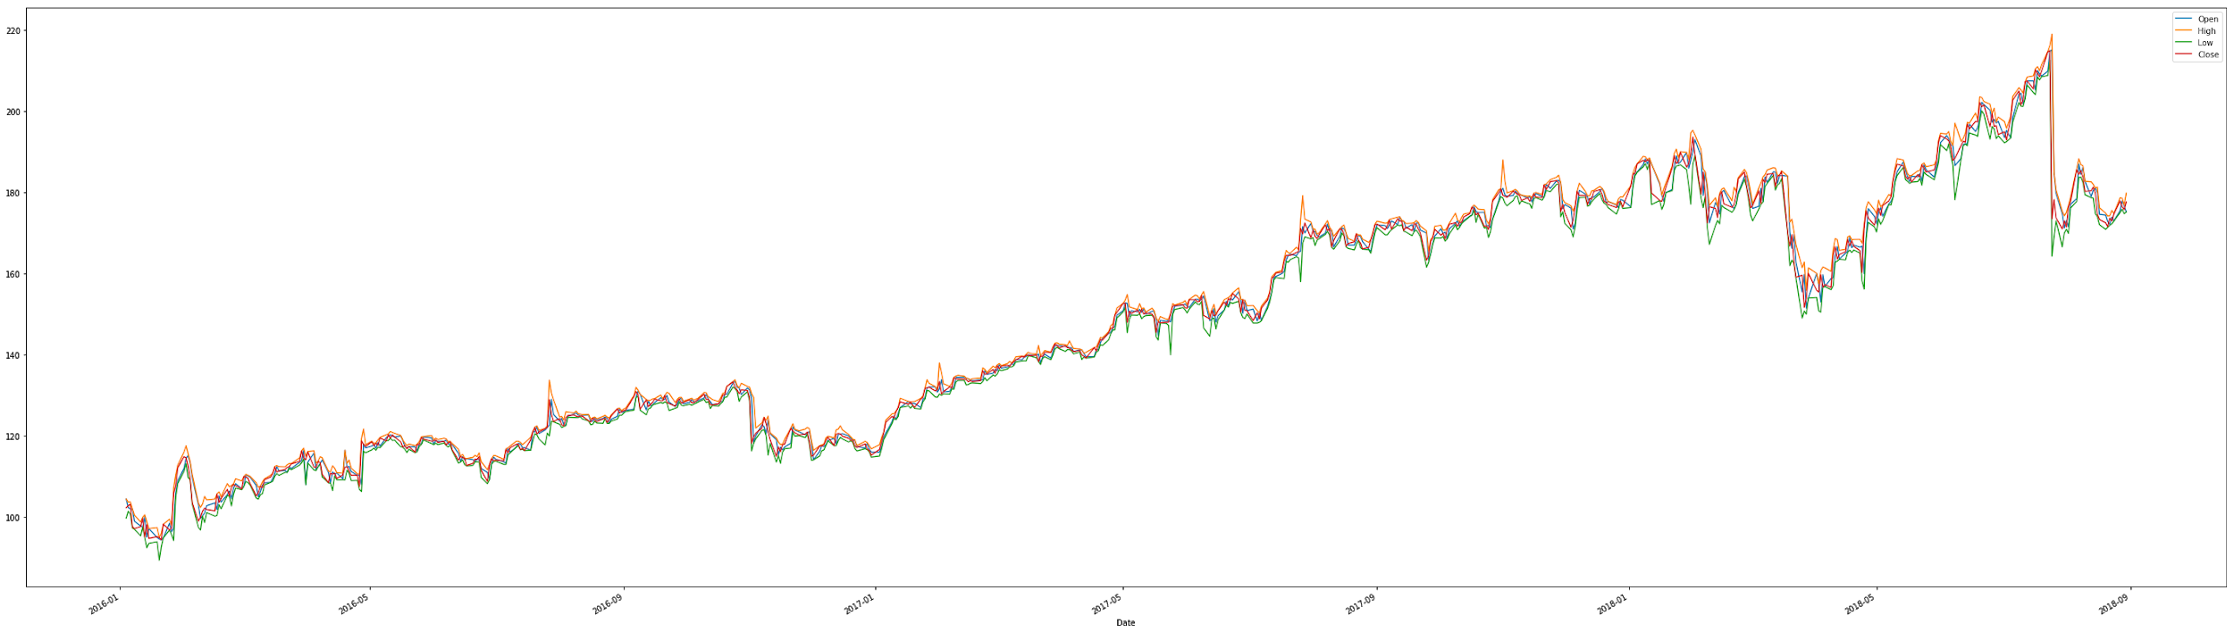
Original Time Series

Slide 3
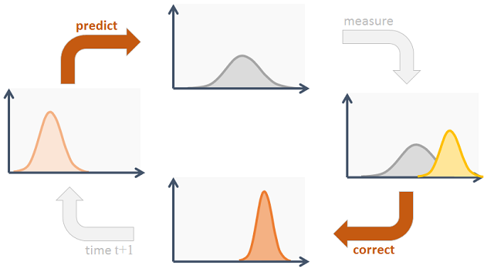
Basics of Kalman Filter
A recursive algorithm that uses a series of observations containing statistical noise and optimally predicts the next state of the system in the presence of the noise.
Features: designed to work with noisy data, incomplete data, on dynamic systems
Process Workflow:: It works in a two-step process- Extrapolation (Prediction) & Update (Correction)
Uniqueness: Predicts the error variance as well
Advantages: Predictive, adaptive and really fast

Slide 4
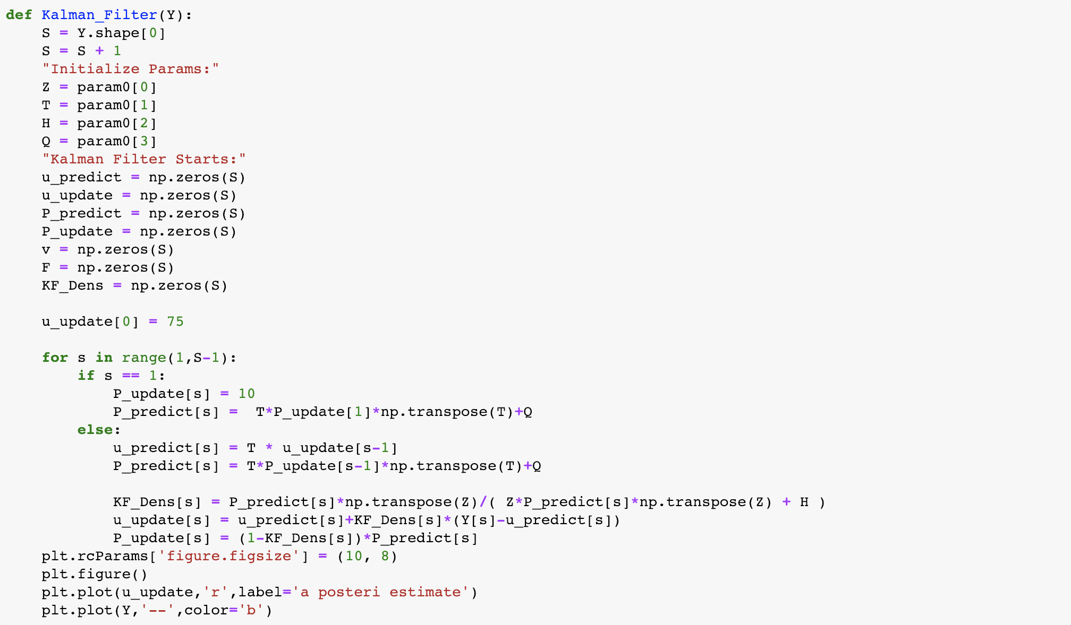
Z: is the noiseless connection between the state vector and the measurement; Assuming stationary
T: is the state transition matrix of the process from the state at k to the state at k+1
Q & R are the covariances of the two noise models and both of them are assumed stationary over time

Slide 5
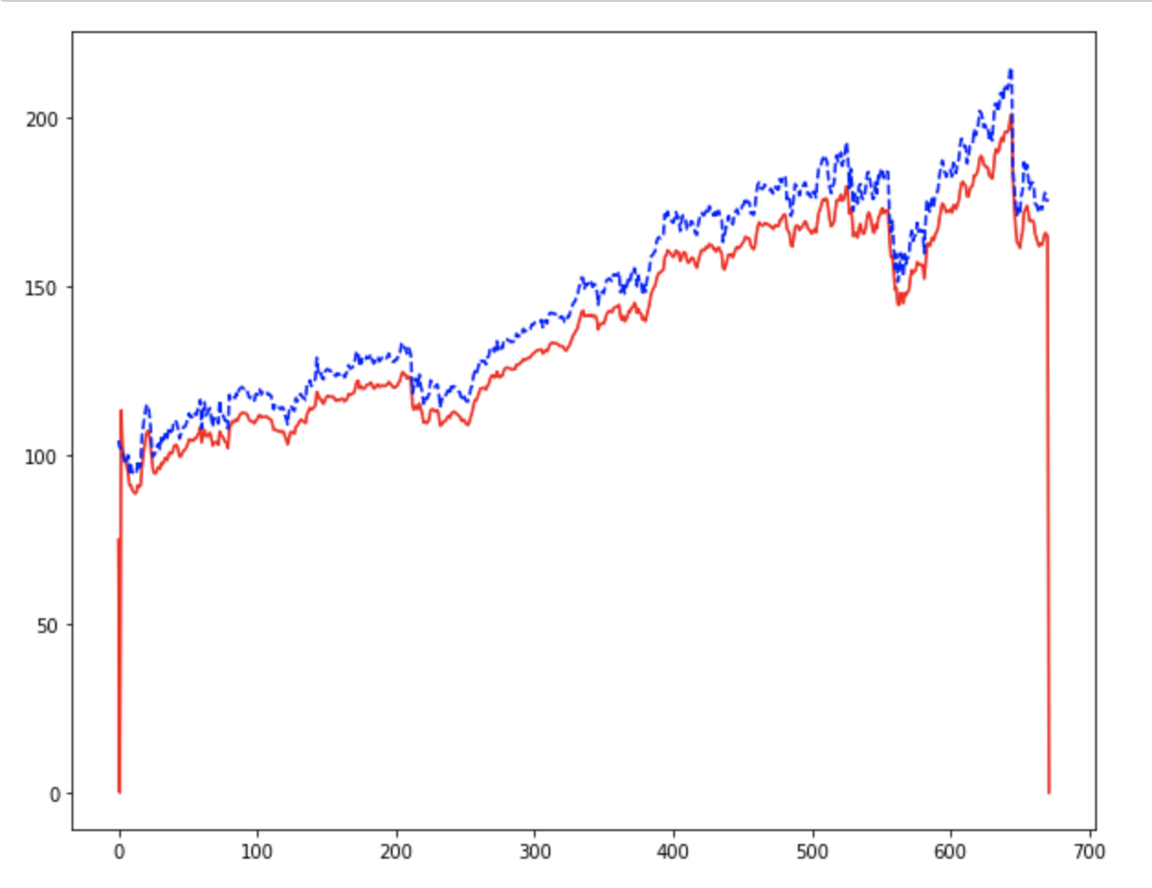
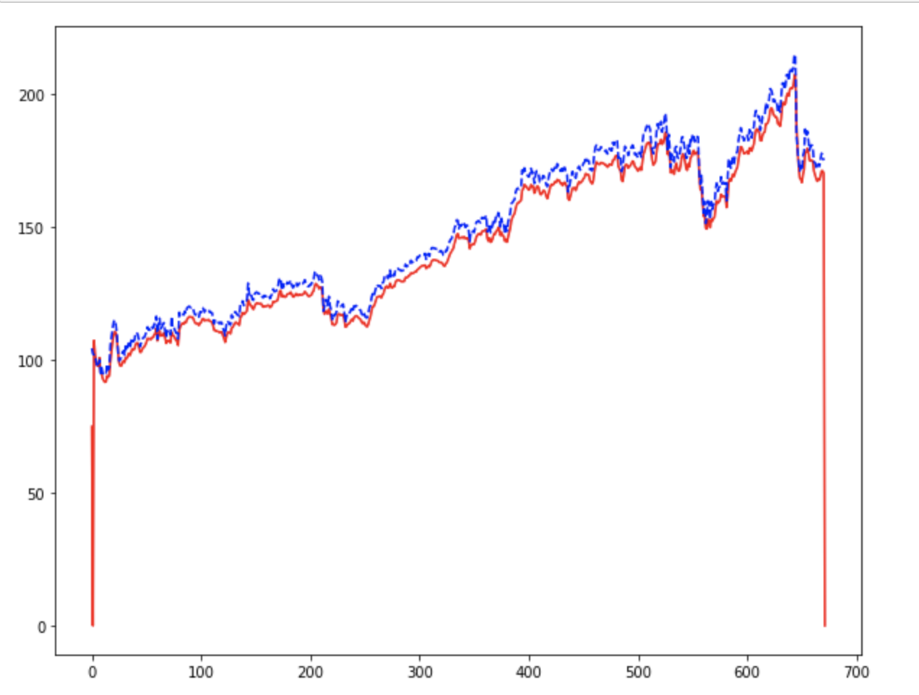
Z & T remain the same and the value = 0.9
Q = 0.0001 & R = 0.0001
Q = 1*10-6 & R = 1*10-6
Red: u_update
Blue dash line: actual value

Slide 6
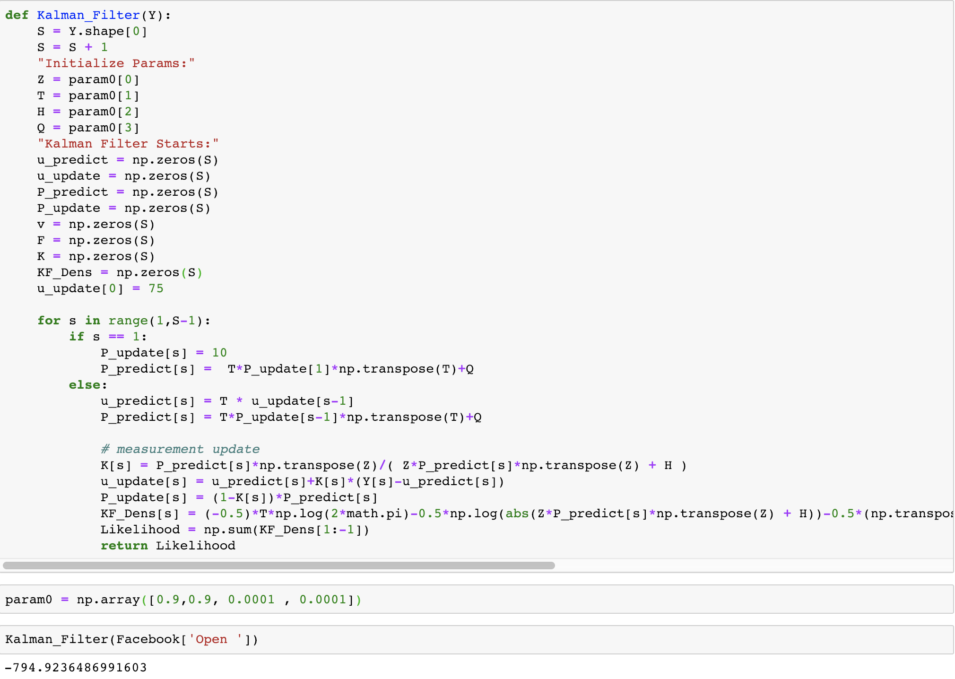
U_update[0] = 75

Slide 7
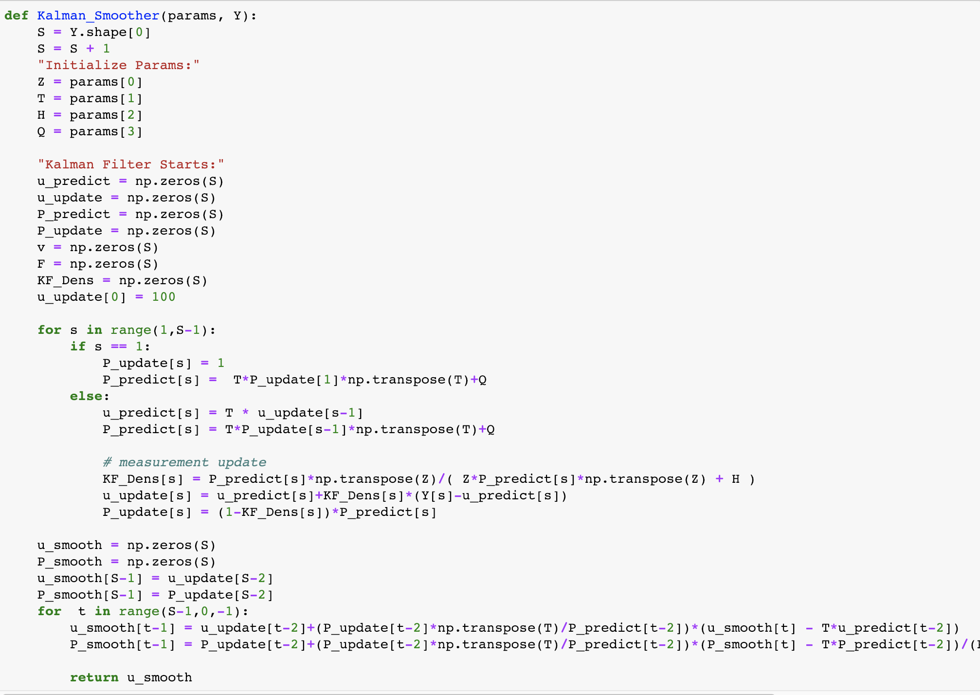
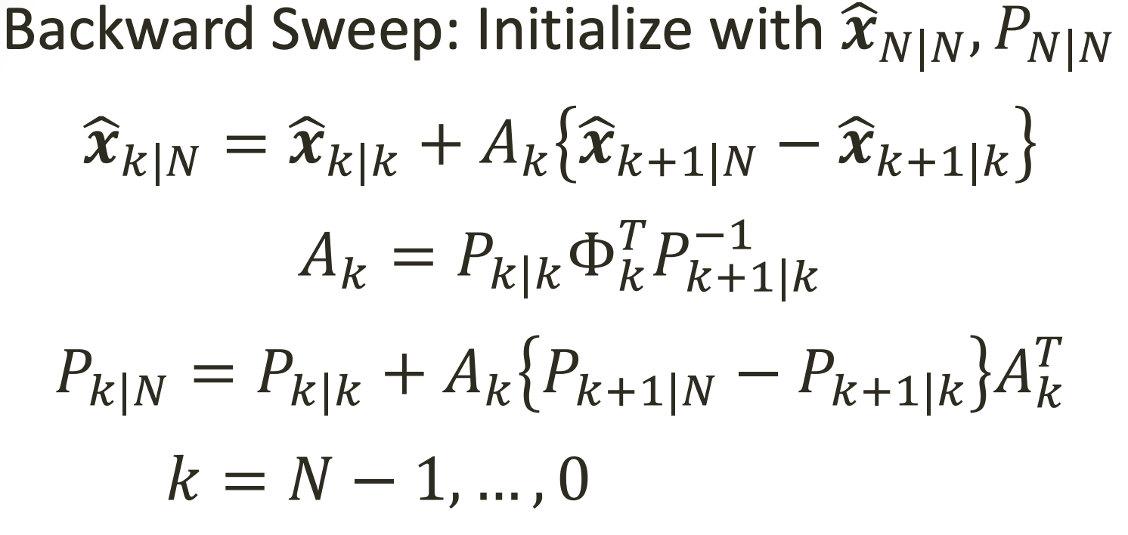
First: We also need to run Kalman Filter in the function
Second: we do the backward thing.

Slide 8
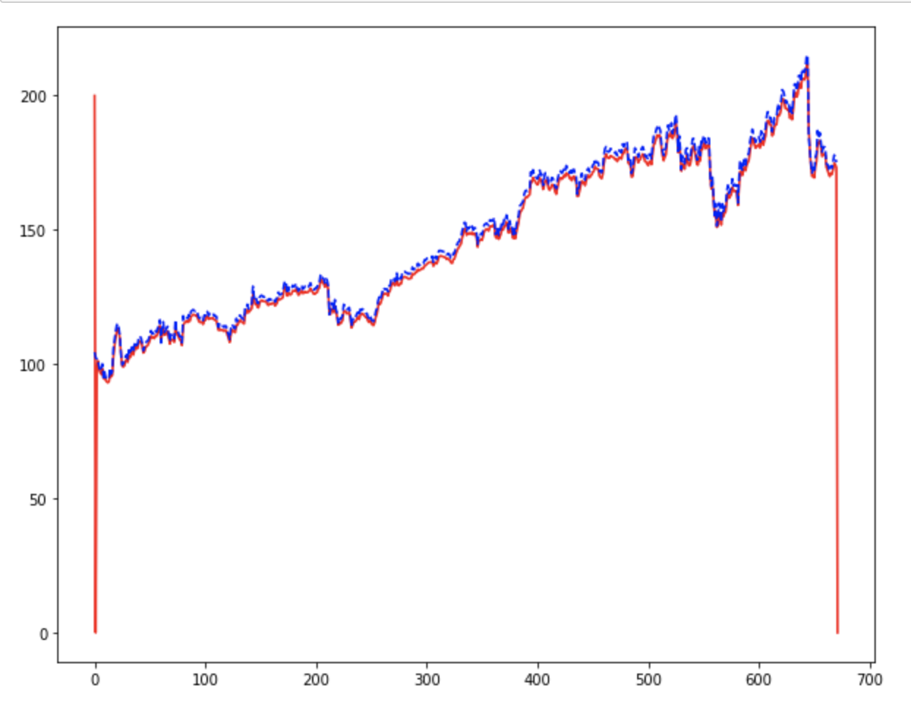

After several time of trials
Conclusion:
For the T and Z have trend that converge to value of 1
Red: u_update
Blue dash line: actual value

Slide 9
Basics of GARCH model
The generalized autoregressive conditional heteroskedasticity (GARCH) is an approach to describe volatility in financial markets.
GARCH aims to minimize errors in forecasting by accounting for errors in prior forecasting, thereby enhancing the accuracy of ongoing predictions. This is the main reason for the wide use of GARCH model in finance.
In GARCH(p,q) model,
p refers to the number of autoregressive lags and
Q refers to how many moving average lags are specified.

Slide 10
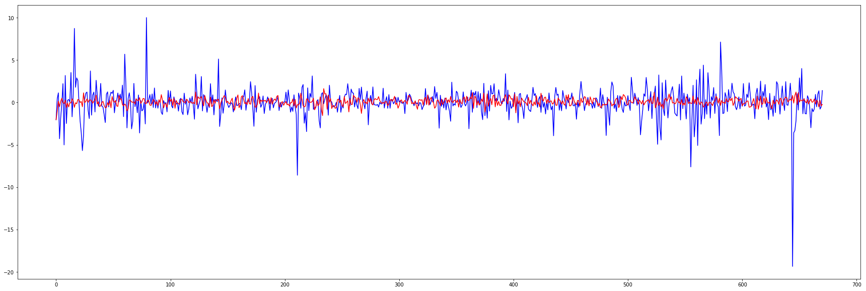
GARCH (1,1) - Daily Return
Mu=0.1, Omega=2.5, Alpha=0.2, Beta=0.3

Slide 11
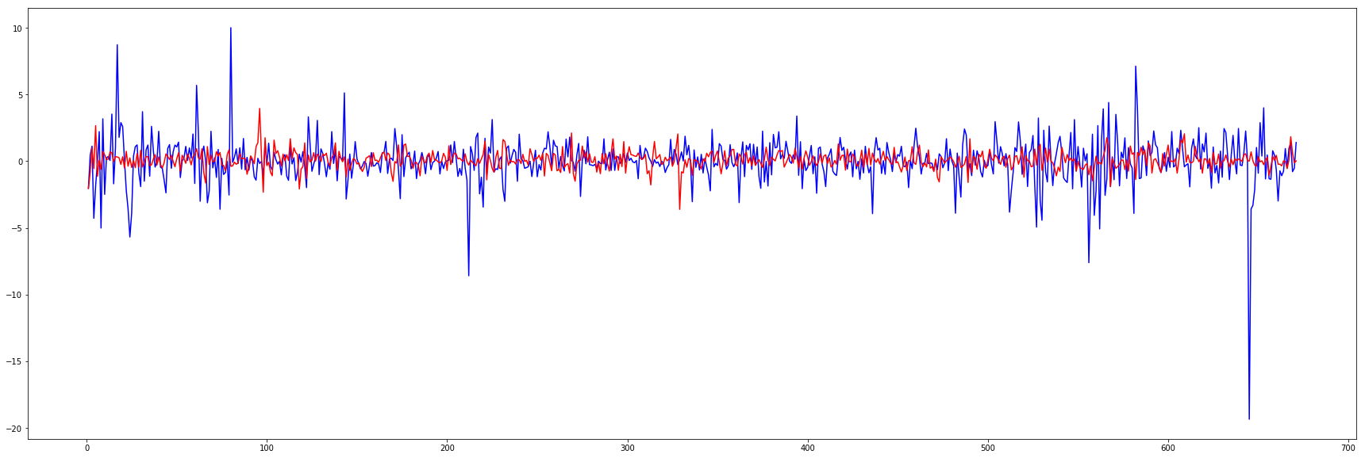
GARCH-t (1,1) - Daily Return
Mu=0.1, Omega=2.5, Alpha=0.2, Beta=0.3, DF=5

